Slide 1
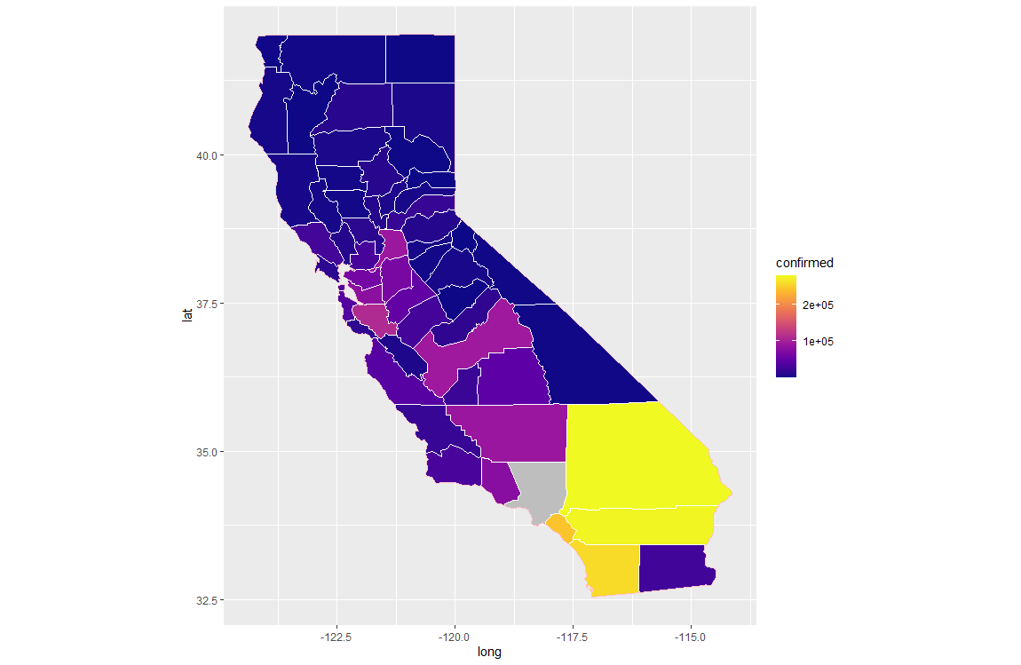
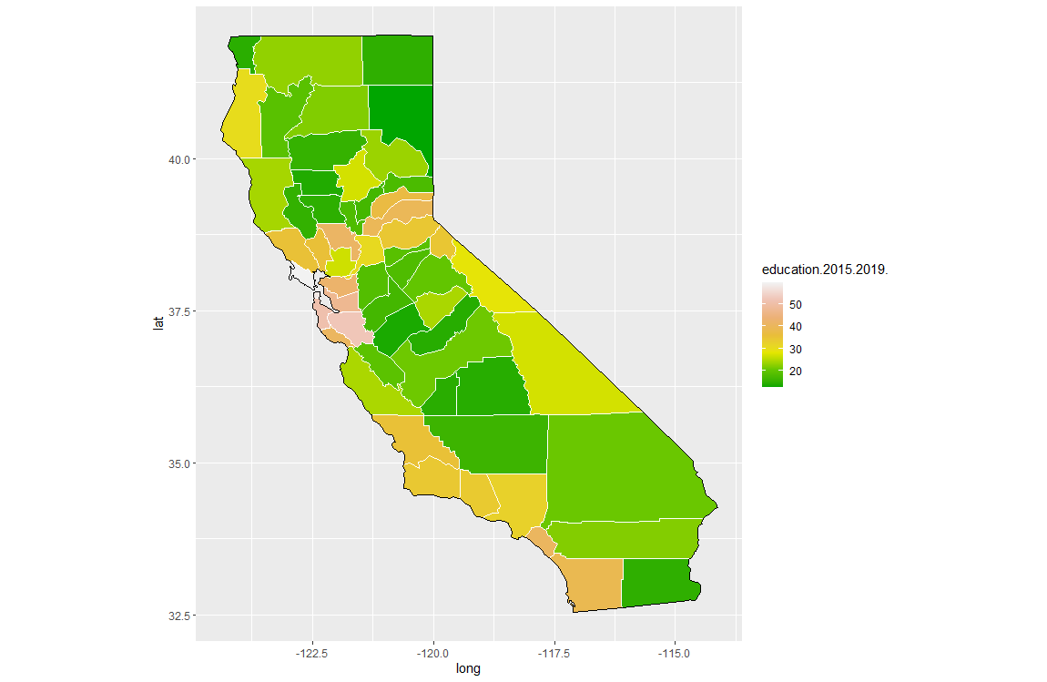

Slide 2
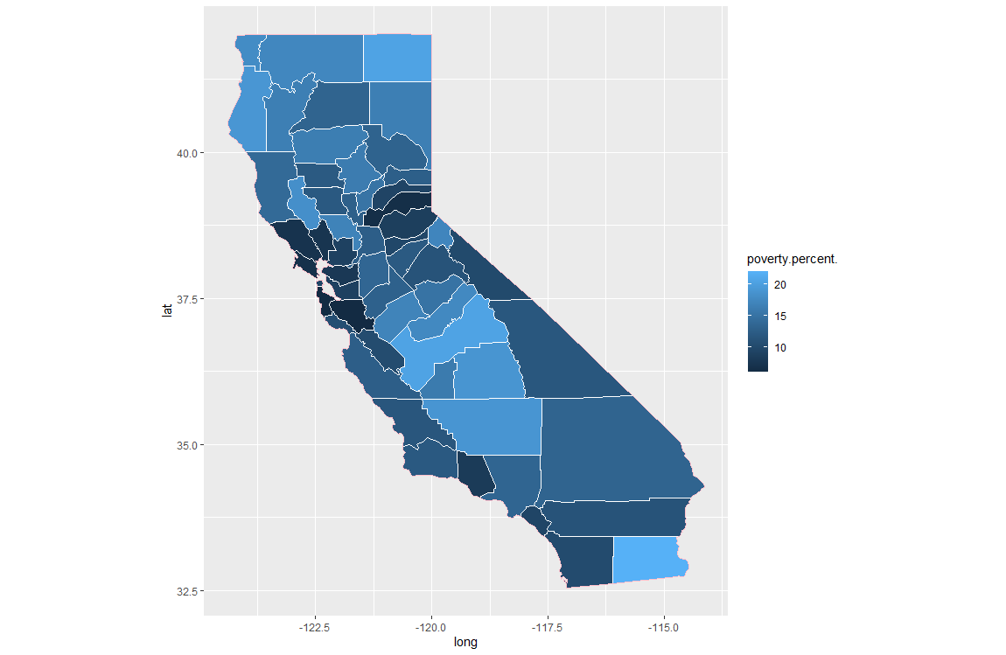

Slide 3
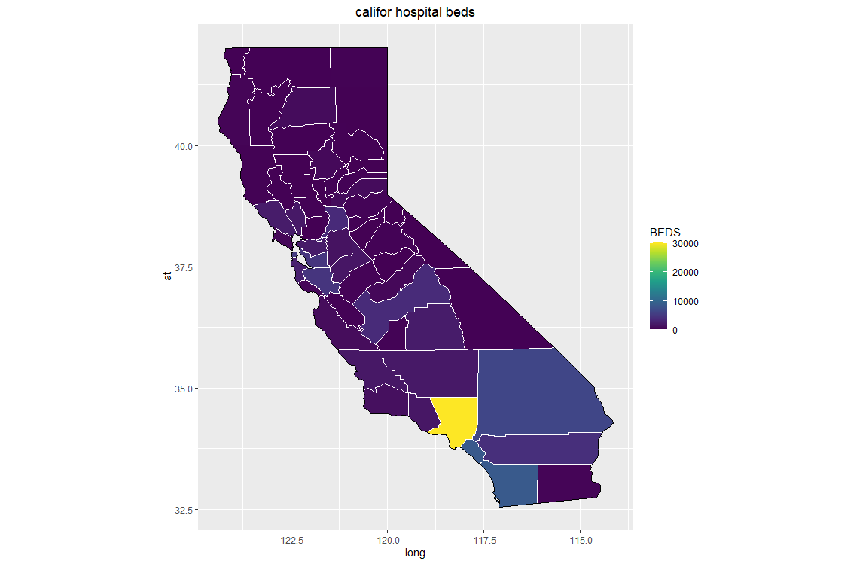

Slide 4
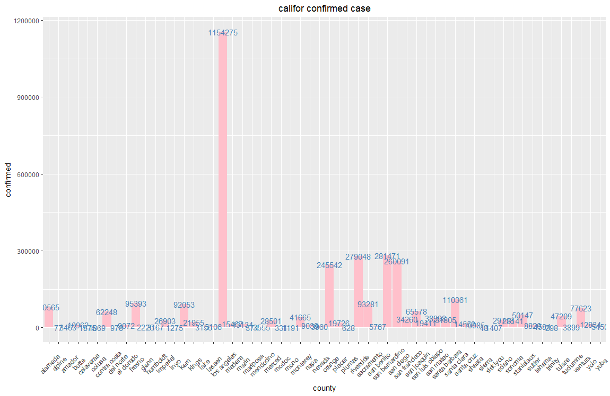

Slide 5
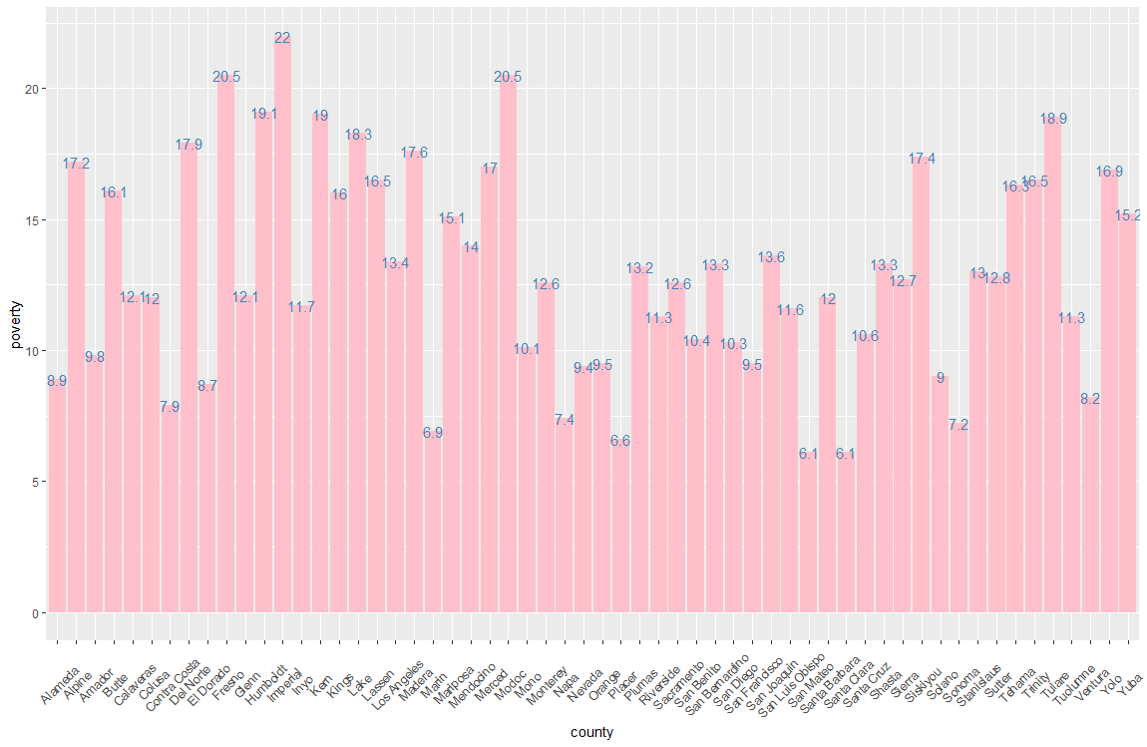

Slide 6
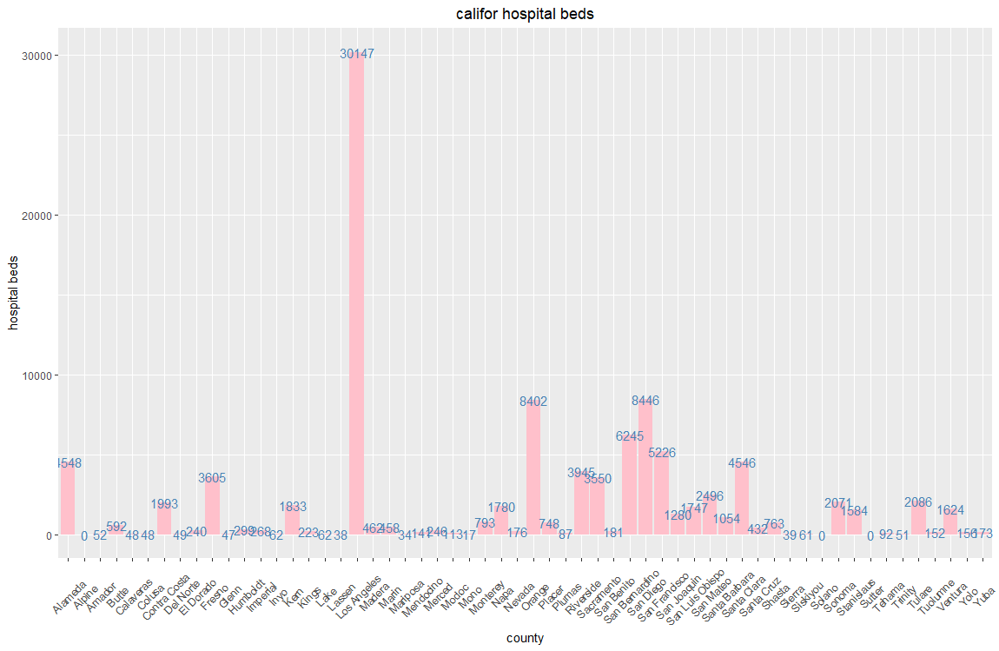

Slide 7
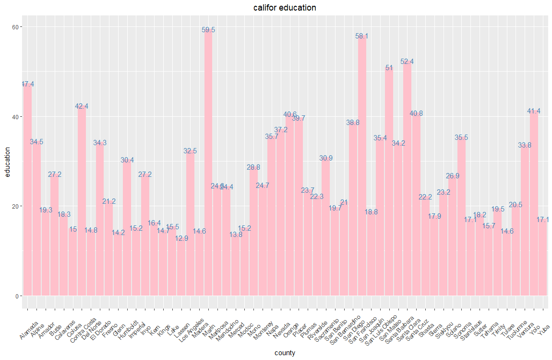

Slide 8
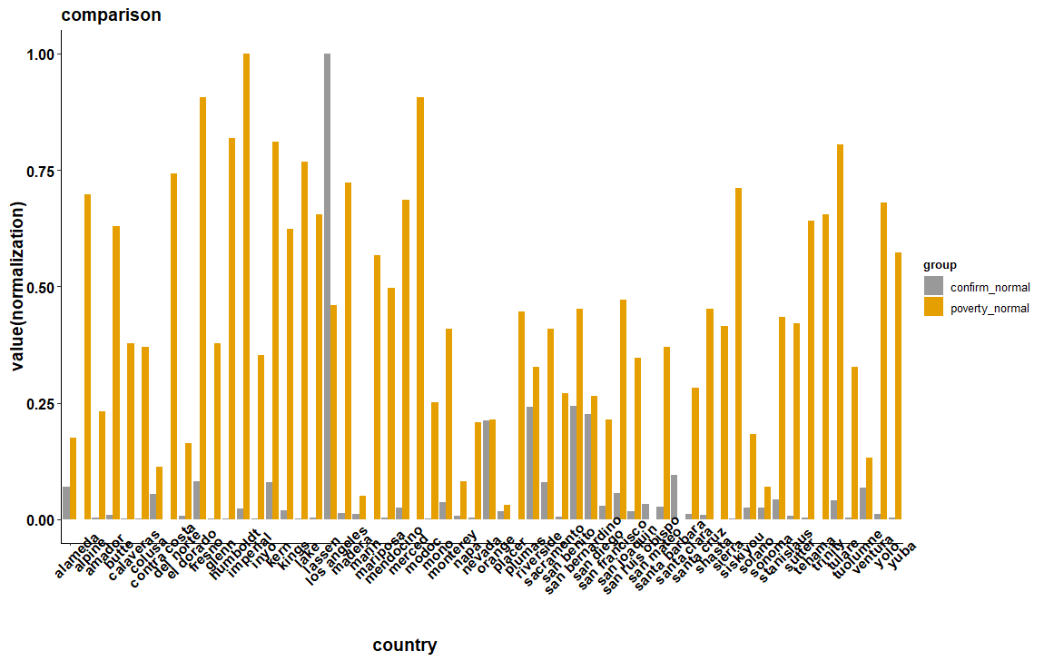

Slide 9
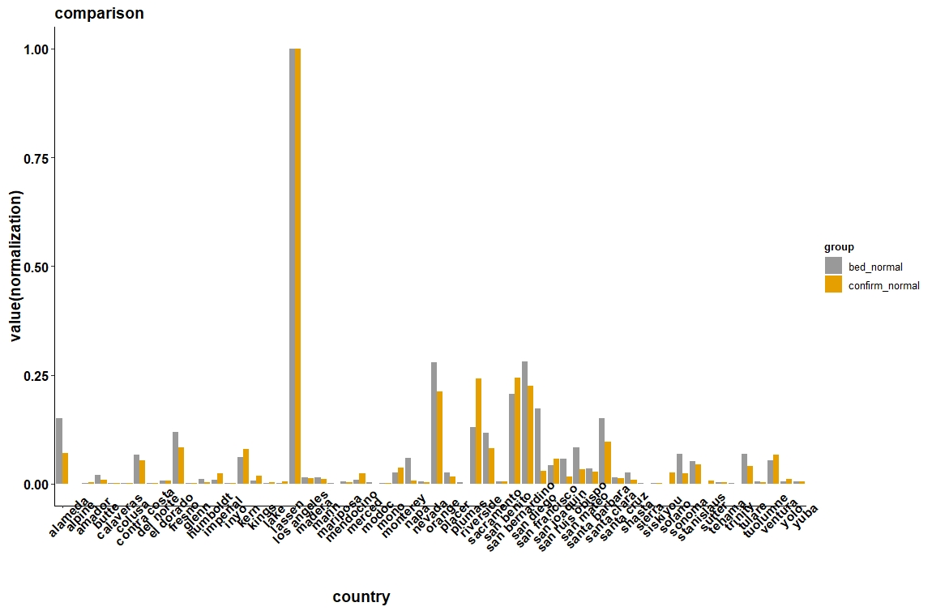

Slide 10
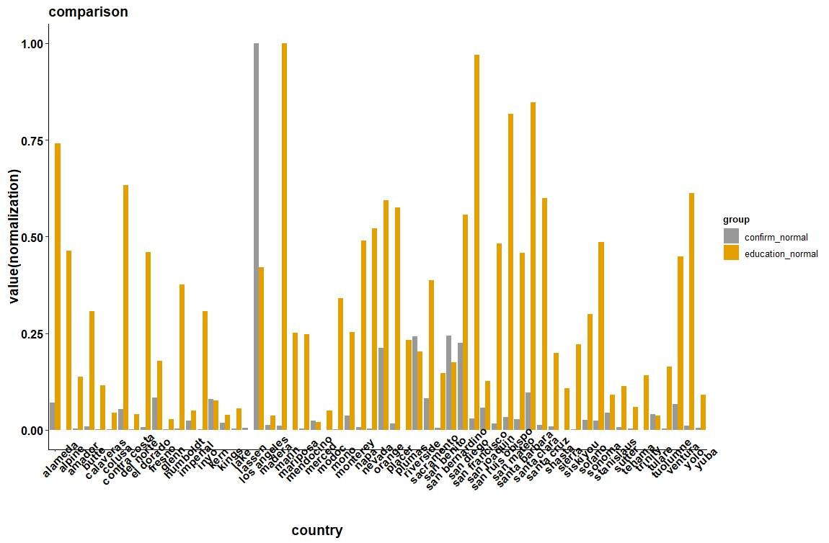

Slide 11
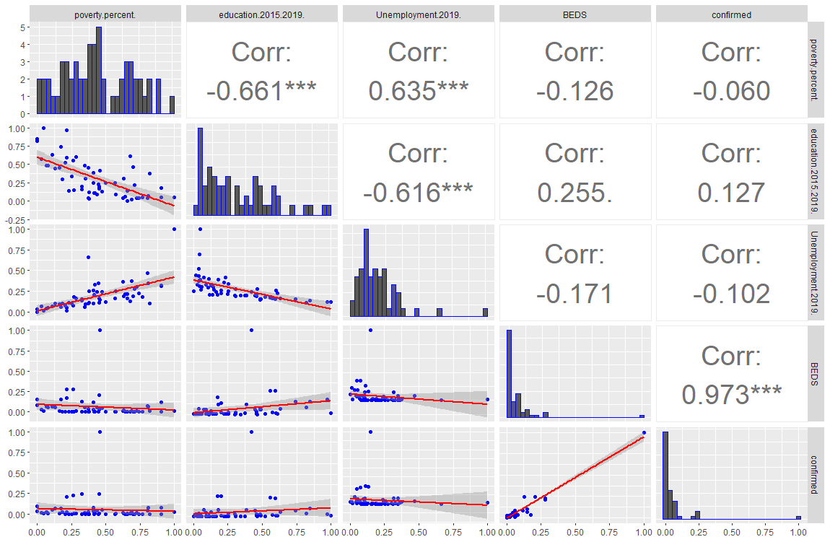
Variable select : poverty、education、unemployment and hospital beds.
In this figure we can see relationship between variables，confirmed case has height correlation with hospital beds (0.973)

Slide 12
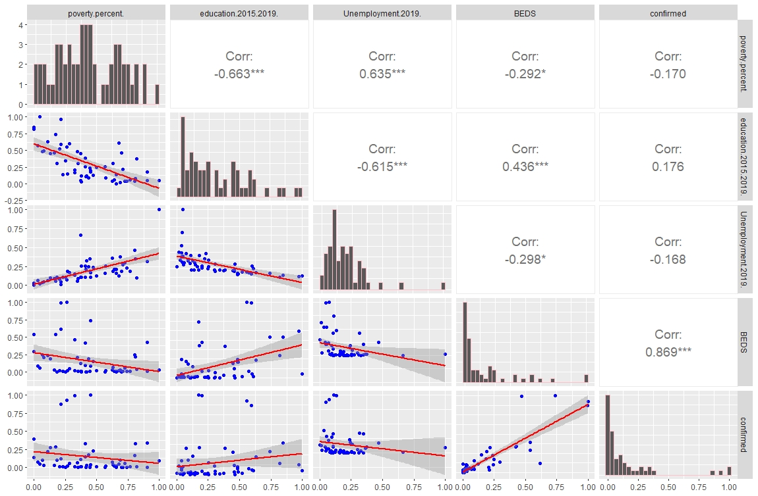
In this figure we remove some data (outlier)

Slide 13
Call:
glm(formula = confirmed ~ ., data = normali_nolosmodel)
Deviance Residuals:
Min 1Q Median 3Q Max
-0.30742 -0.05082 -0.01224 0.03850 0.49673
Coefficients:
Estimate Std. Error t value Pr(>|t|)
(Intercept) 0.11877 0.05698 2.085 0.042036 *
poverty.percent. -0.07761 0.08331 -0.932 0.355833
education.2015.2019. -0.29777 0.08520 -3.495 0.000978 ***
Unemployment.2019. -0.02703 0.12292 -0.220 0.826801
BEDS 0.99550 0.06851 14.531 < 2e-16 ***
---
Signif. codes: 0 ‘***’ 0.001 ‘**’ 0.01 ‘*’ 0.05 ‘.’ 0.1 ‘ ’ 1
(Dispersion parameter for gaussian family taken to be 0.01225878)
Null deviance: 3.35571 on 56 degrees of freedom
Residual deviance: 0.63746 on 52 degrees of freedom
AIC: -82.36
Number of Fisher Scoring iterations: 2

Slide 14
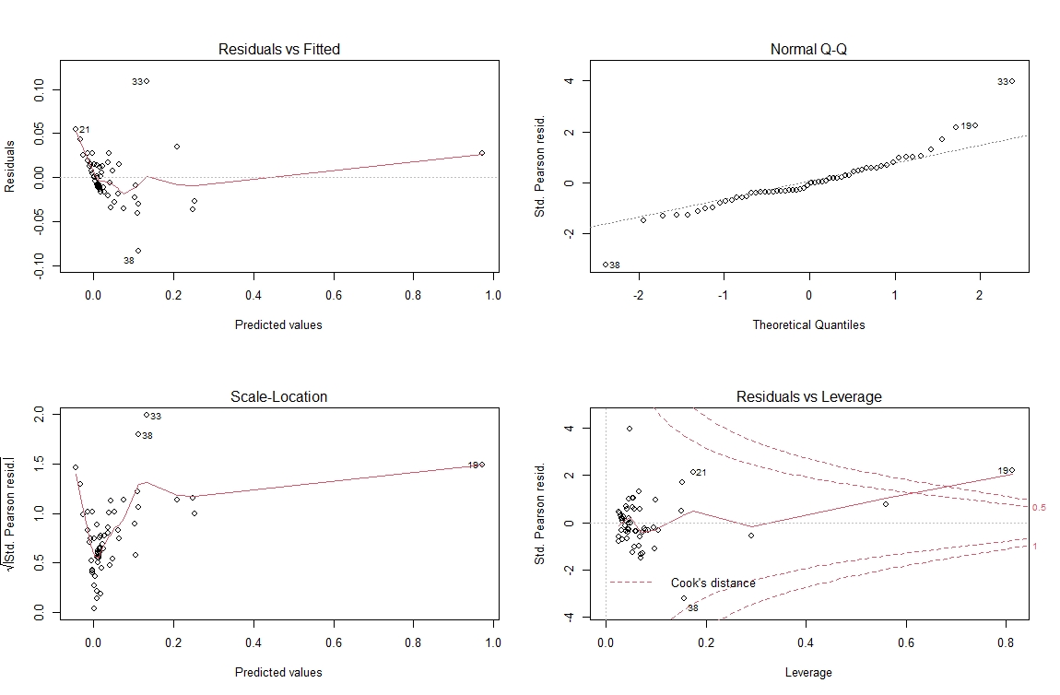
fit glm

Slide 15
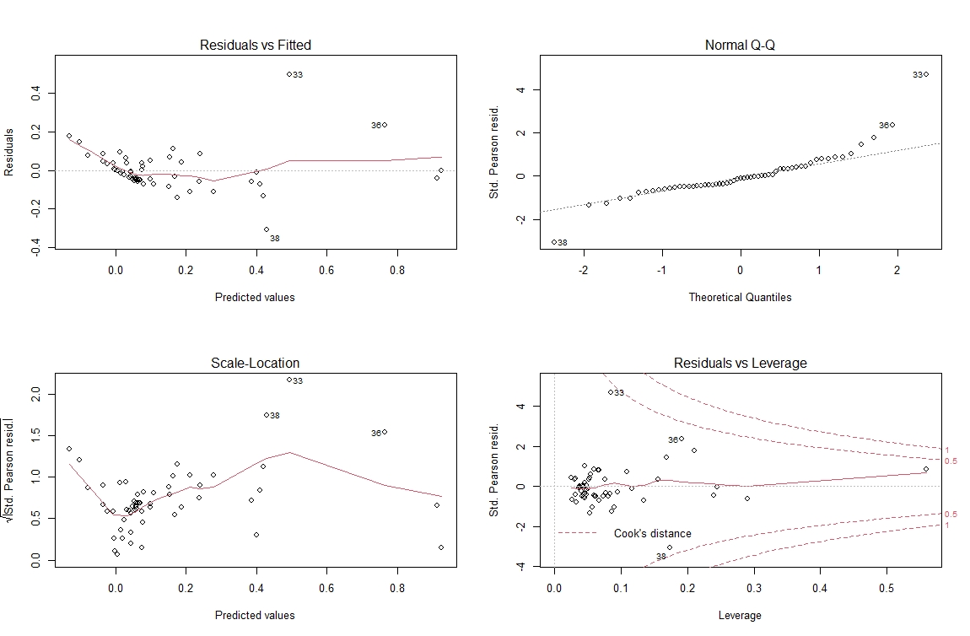
fit glm after remove some data (outlier)

Slide 16
Data size : 140000+
contain : wind speed、temperature、humidity、precipitation

Slide 17
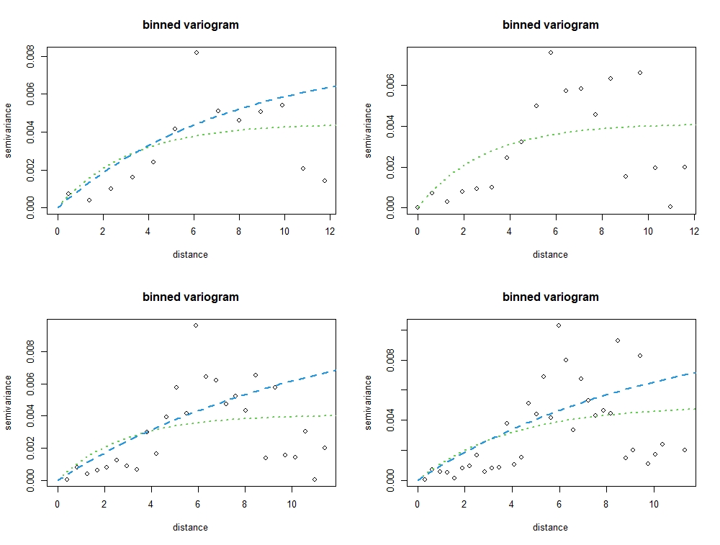
Variogram
estimate
sigmasq phi tausq kappa
initial.value "0" "3.16" "0" "0.5“
loss value: 7.95819451553793e-05
sigmasq phi tausq kappa
initial.value "0.01" "7.58" "0" "0.5“
loss value: 450.812958534789
sigmasq phi tausq kappa
initial.value "0" "3.16" "0" "0.5“
loss value: 4.26731879710498e-05
(WLS) sigmasq phi tausq kappa
initial.value "0.01" "10.29" "0" "0.5“
loss value: 570.100708440749
(OLD) sigmasq phi tausq kappa
initial.value "0" "3.67" "0" "0.5“
loss value: 0.000192029819973333
sigmasq phi tausq kappa
initial.value "0.01" "11.27" "0" "0.5“
loss value: 480.927558242907
sigmasq phi tausq kappa
initial.value "0" "2.94" "0" "0.5“
loss value: 0.00012630607414439

Slide 18
Main problem

Slide 19
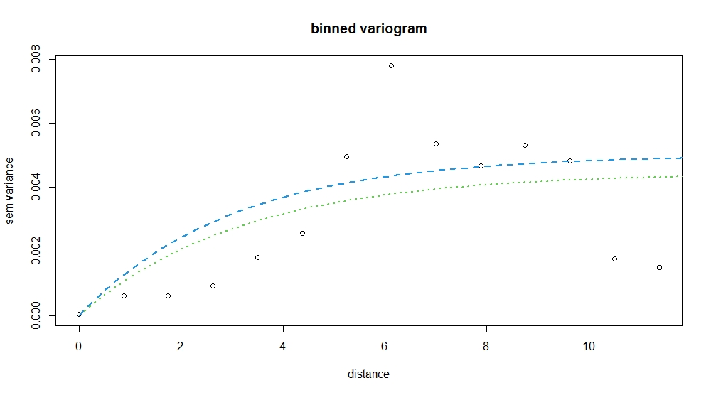



7/12 meeting
${\text{V}}_{\text{Y}}$ (u) = ${\text{τ}}^{\text{2}}$ + ${\text{σ}}^{\text{2}}${1 − ρ(u)}
Where ρ(u)= exp(−||s − u|| / λ)
sill
range
(WLS) ${\text{σ}}^{\text{2}}$(sill) $φ$(range) ${\text{τ}}^{\text{2}}(nugget)$ $λ$
value "0.005" "3.000 “ "0" “1“
nugget
(OLD) ${\text{σ}}^{\text{2}}$(sill) $φ$(range) ${\text{τ}}^{\text{2}}(nugget)$ $λ$
value "0.0044" “3.00“ "0" “1“

Slide 20
